Slide 1

Crowd Management System Using Zone-Based BFS Graph Traversal
Department Of Computer Science Engineering
Lovely Professional University, Punjab
Name of group members:
PRAKRITI SINGH – 12308985
PRATEEK KUMAR SINHA – 12321106
LOKESH KUMAR REDDY – 12301738
MANCHIKANTI MEGHAVARDHAN – 12318864
RAUNAK MISHRA - 12318274
Guidance Under:- Anshu sharma
Chirag sharma
Shilpa sharma

Slide 2

Introduction
In crowded places like temples, stadiums, railway stations, or fairs, it becomes difficult to control the movement of people. If not managed properly, this can lead to accidents like stampedes. The aim of this project is to design a Crowd Management System that divides the area into smaller parts called zones. Each zone is treated as a node in a graph.
We use a method called BFS (Breadth First Search) to find the safest and shortest path for people to move from one zone to another while avoiding overcrowded areas. The system updates zone status based on crowd density and helps guide people through less crowded paths.
The project is implemented using C, C++, and Java. C is used for basic logic, C++ for advanced data handling, and Java for user interface. This system can be very useful for security teams to manage large crowds and prevent dangerous situations.

Slide 3

LITERATURE REVIEW
Several crowd management techniques exist, such as RFID tracking, CCTV monitoring, and AI-based heatmaps. However, many of these systems lack dynamic pathfinding.
This project builds on research involving:
BFS and DFS traversal in pathfinding
Zone-based partitioning in smart cities
Safety algorithms in public transport and festivals
The BFS method is proven to be fast and effective for shortest path detection in graphs, which makes it suitable for real-time crowd navigation
LITERATURE REVIEW

Slide 4

Importance of Crowd Management
Crowd management is crucial for safety and efficiency. It helps in preventing accidents, ensuring smooth flow, and providing assistance in emergencies. By effectively managing crowds, event organizers can enhance the overall experience and satisfaction of attendees.

Slide 5
Challenges in Managing Crowds
Overcrowding in Zones
Too many people gather in one area, increasing risk of stampede or panic.
Lack of Real-time Monitoring
Authorities can't track people zone-by-zone, leading to delayed decisions.
Uncontrolled Movement
People may ignore directions and enter wrong or restricted zones.
Emergency Situations
It's hard to quickly evacuate people during fire, medical, or security threats.
Poor Communication
Instructions may not reach the crowd effectively, causing confusion and chaos.

Slide 6
Role of Technology in Crowd Control
Technology plays a huge role in modern crowd management. From mobile apps that provide real-time updates to surveillance cameras that monitor crowds, tech helps improve safety and efficiency. It allows organizers to analyze crowd behavior and response times, making adjustments on the fly to prevent issues before they arise.

Slide 7
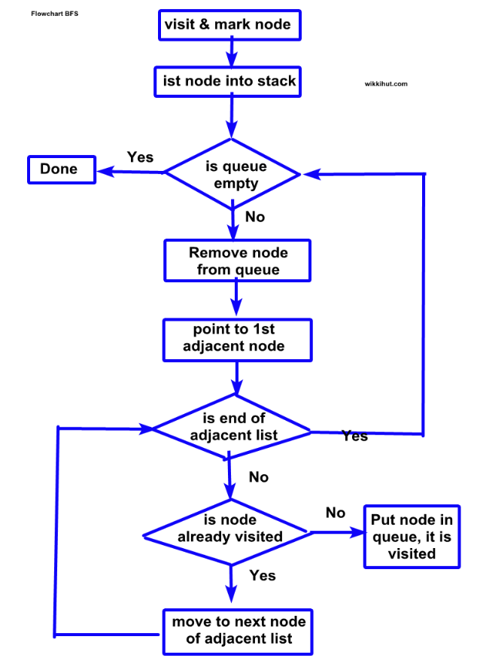
What is Graph Traversal?
Graph traversal is a method used to visit and explore nodes in a graph. It’s like navigating a map. You can visualize it as determining the best route to reach a destination, ensuring you don’t miss any key points along the way. This concept is essential in creating efficient paths for crowd movement.

Slide 8

Understanding BFS (Breadth-First Search)
BFS is a technique that explores all neighbors at the present depth before moving on to nodes at the next depth level. It’s an effective way to find the shortest path in a network or layout, making it perfect for strategizing crowd movement in different zones.

Slide 9
Application of Zone-Based BFS in Crowd Management
With zone-based BFS, we can divide areas into manageable sections, allowing for organized movement and better control. This approach can help in evacuations, directing crowds to safety, or optimizing entry and exit points during events, ensuring everything runs smoothly and safely.

Slide 10
Conclusions
The Crowd Management System using Zone-Based BFS Graph Traversal provides an efficient and smart way to control large gatherings. By dividing the area into zones and using the Breadth First Search (BFS) algorithm, we can monitor crowd movement, detect overcrowded zones, and guide people safely in real-time. This system helps reduce risks of stampede, panic, and delays during emergencies. It also supports better decision-making for authorities through zone-wise crowd tracking and alternate route suggestions. Overall, this system ensures safe, organized, and intelligent crowd management during public events or emergency situations.

